Slide 1
Intermediate Analytics Group Project AlY 6015 – CRN 21370 3/27/2019
MSP Auto Industry Sales Data
By:
Peter Akorede
Sirohi Kshitiz
Marvin perez

Slide 2
INTRODUCTION
Profit is what drives every institution. No institution is created to dash out cash without expecting something in return. They all thrive and survive on profit they make from services offered to their customers. For this reason, most firms task their managers (particularly those that head the sales & marketing department) with exploring new ways and opportunity to maximize and increase profitability from goods and services offered while running on a low expense.

Slide 3
BUSINESS PROBLEM
MSP Autos Industry is currently pondering on expanding its business venture. After the annual general meeting, they concluded it was best for them to maximize sales and profit from current product categories. The data team has been tasked to help identify areas of strength and weaknesses. In addition, they are to make recommendation(s) on how to improve sales from the weak territories.

Slide 4
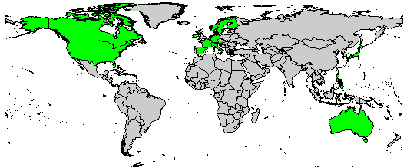
OVERVIEW
MSP’s Market
Top 3:
USA – 36%
Spain – 12%
France – 11%
Bottom 3:
Belgium – 1.08%
Philippines – 0.94%
Ireland – 0.58%

Slide 5
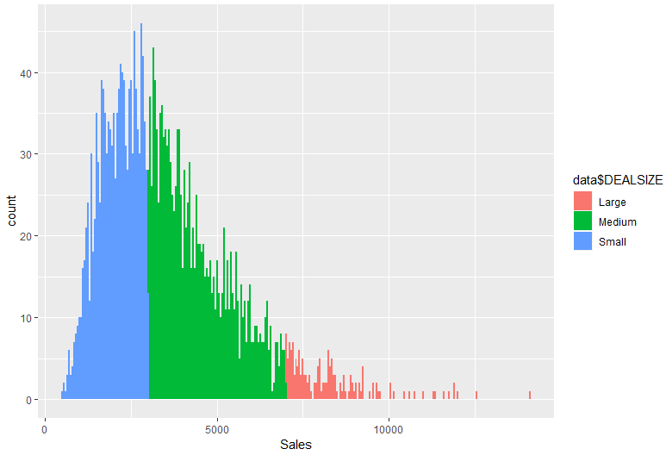
OVERVIEW
Distribution of Deal Size:
Large: 13%
Medium: 61%
Small: 26%

Slide 6
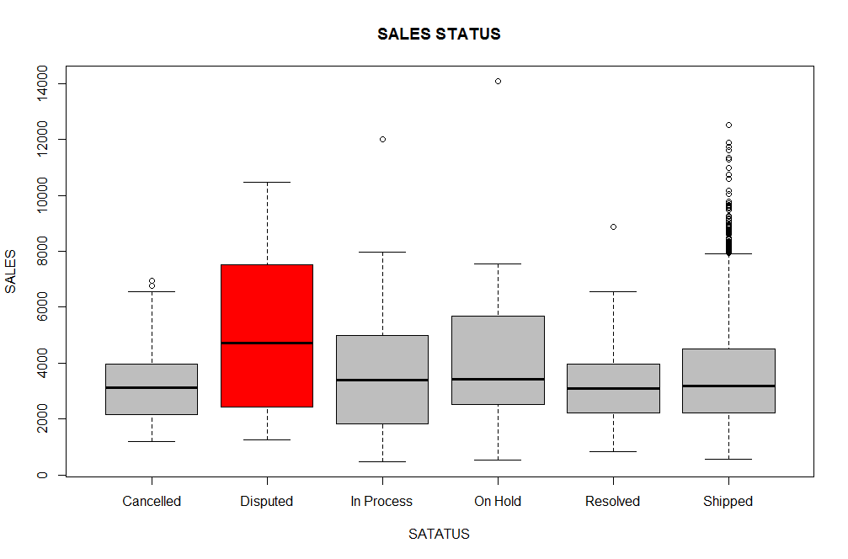
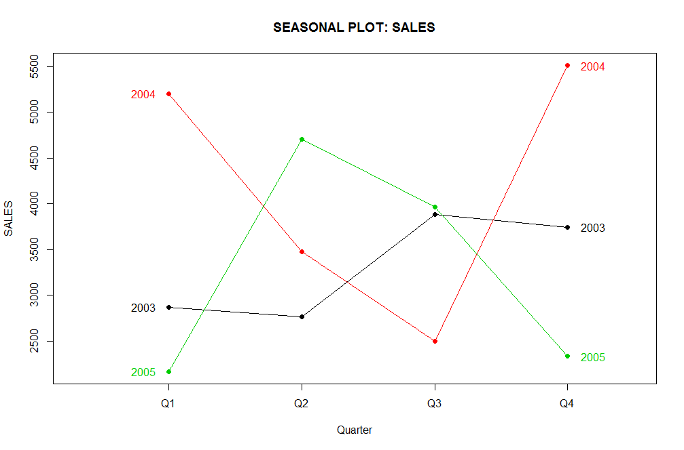
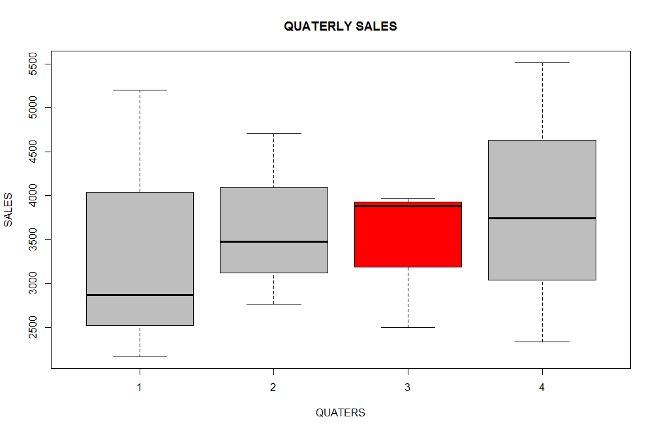
Descriptive Analytics: Journey so far (2003-2005)
Over the past three years, there are more disputed sales than sales shipped and received
Sales in the Q3 of every year start well but ends poorly
Q2 drop in sales for two consecutive year i.e. 2003 and 2004
Highest sales always come in Q4

Slide 7
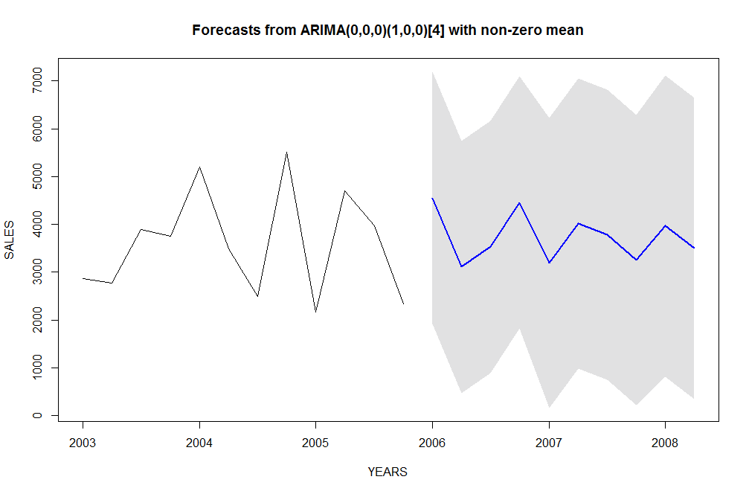
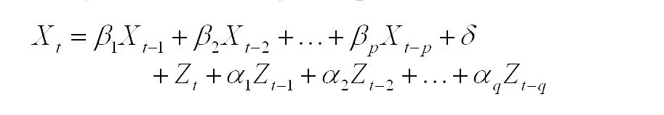

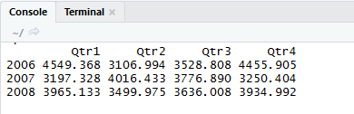
THREE YEARS SALES FORECAST 2006-2008
Autoregressive Moving Average (ARMA) Model
ARIMA MODEL (0,0,0)(1,0,0) i.e. AR(1) is used.
Sales projected to increase in the first quarter of 2006 by 82%
Sales projected to drop between 2007 and 2008

Slide 8
Segregation of Data
Create clusters of Data
Determine clusters with less sales
Variable used:
Quantity of order
status of order
quarter
deal size
sales
Use of “Gower” distance due to mix data types.

Slide 9
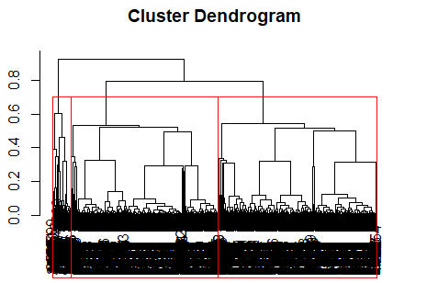


Slide 10
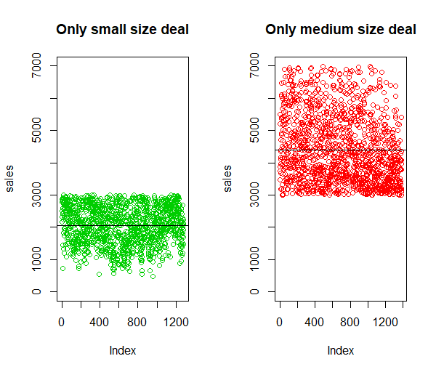



Slide 11
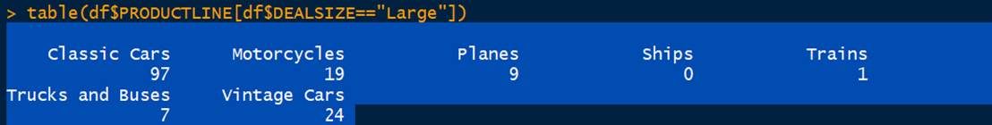
Outcome
Large deals mainly have classic cars, not ships and planes.
Deal size increases the mean sales value.
Company needs to focus on increasing big size deal.

Slide 12
Conclusion
Q3 Promotions
Maintain Large Deals
Countries
Q4 strongest quarter
Uncharted markets
Canada(2%); Belgium(4%)
Make Classic Cars, Vintage Cars Top 2 in countries that are almost there
Focusing on deals/promotions in Q3 that will carry over
(China, India, S.Korea)
(Belgium, Japan, Finland)

